Slide 1
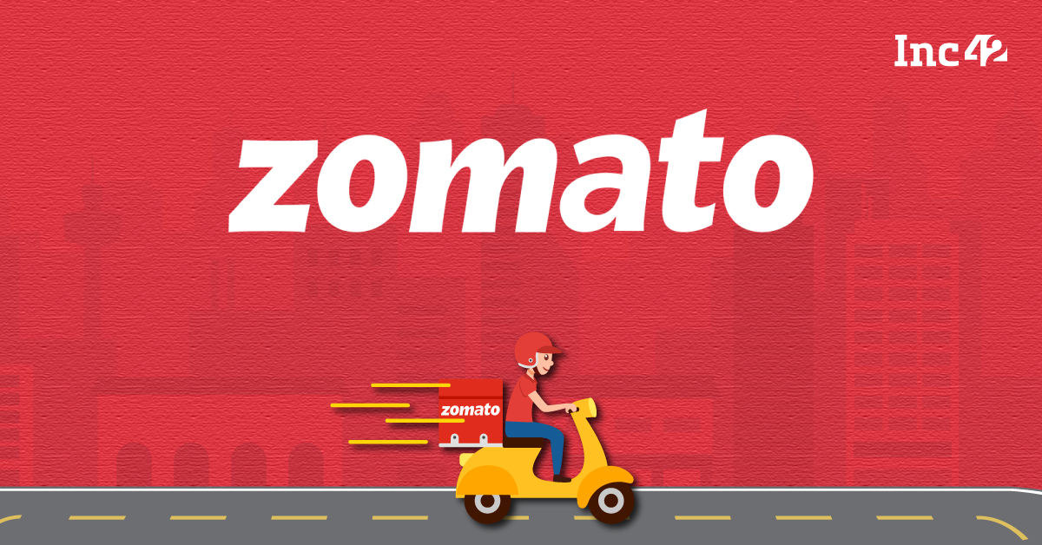
Zomato’s Global Expansion Strategy: Data-Driven Insights
AYUSH NAUTIYAL
06/03/2025

Slide 2
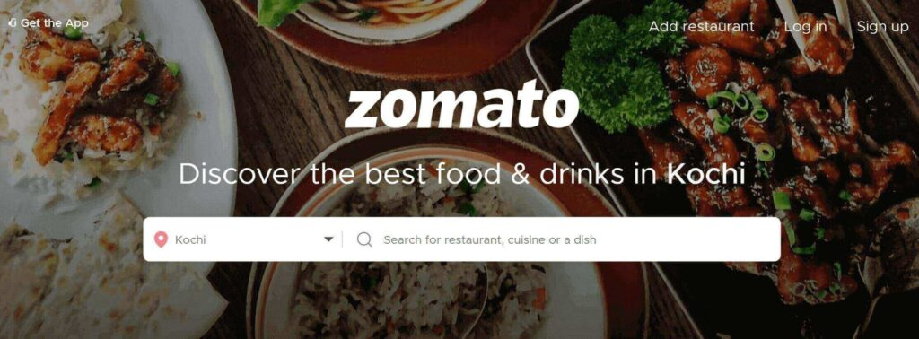
Interesting fact about Zomato
2008: Founded as FoodieBay, a restaurant discovery platform.
2010: Rebranded as Zomato to expand global reach.
2015: Launched food delivery services, revolutionizing the business model.
2020-Present: Expanded globally, acquiring startups and entering new markets.

Slide 3
Introduction
With rapid growth in the food delivery sector, strategic expansion is key to Zomato’s success.
This analysis focuses on identifying the best markets, understanding customer demand, and assessing competition.
Objectives
Identifying global expansion opportunities through competitive analysis
Analyzing market competition.
Understanding customer preferences and pricing strategy.
Cuisine preferences and rating correlations.
Financial and strategic decision-making.

Slide 4
Data Overview
Total Restaurants Listed: 9551,reflecting Zomato’s extensive market presence.
Geographical Coverage: Operations span 15 countries and 141 cities, showcasing international reach.
Active Restaurants: 7443 establishments currently serving customers.
Cuisines offered: 1827 distinct cuisines, highlighting a diverse culinary portfolio.
Refined Dataset: Removed non-essential attributes such as latitude and longitude, Localityverbose as
detailed address data was available.
Data Completeness: Replaced missing values in the Cuisines column with Mode of Cuisine column i.e most
common dish for consistency.
Currency Standardization: Introduced a pricing column aligned with each country's respective currency for
accurate financial insights, and a common currency column(INR) for financial analysis.
Data Lookup: Implemented the VLOOKUP function to efficiently retrieve country names from the
country_description table using corresponding country codes.
This dataset provides a comprehensive view of Zomato’s global footprint, supporting market expansion strategies.
Competitive Landscape Analysis helps identify underpenetrated cities, unlocking opportunities for restaurant growth.
Understanding cuisine trends and pricing structures enhances decision-making for market positioning and consumer engagement.

Slide 5
Analytical Approach and Tools
Data cleaning: Utilized function like remove duplicates on unique identifier(restaurant id) and removing irrelevant columns like locality, localityverbose, latitude and longitude.
Data Enrichment: Enhanced dataset with additional variables :Country, Price, Conversion factor(INR), Average_price_of_two (INR) using lookup functions(Vlookup) concatenate function.
Descriptive Analysis: Employed Pivot Tables for summarizing key metrics such as Global Rating Trends, Top cuisines and Global restaurant distribution and many more.
Visualization: Created dynamic visualizations on Resturants growth trends, global distribution of restaurants, online delivery vs table booking distribution and many more

Slide 6
Problem Statement
How can a food delivery platform expand into new markets while ensuring strong brand presence and user adoption?
What strategies can improve customer satisfaction in online food delivery compared to dine-in services?
What measures can increase customer engagement and repeat usage in low-interaction regions?

Slide 7
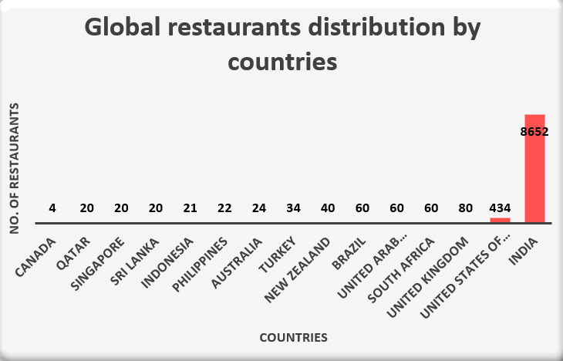
Global Restaurant Distribution :
India dominates with 8,652 restaurants, making it the most mature and established market.
Other countries have significantly lower restaurant counts with U.S(434) being second largest.
Several countries such as Canada(4), Qatar(20) and Singapore(20),Sri Lanka(20),Indonesia(21) have minimal restaurant presence, indicating untapped potential.

Slide 8
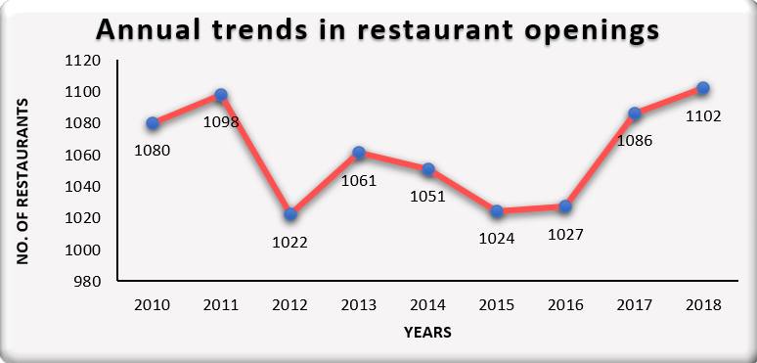
Restaurants growth trends :
Fluctuations in openings can be observed as, there are peaks in 2011 (1,098) and 2018 (1,102) which indicate strong growth years, while 2012 (1,022) and 2015 (1,024) saw slowdowns.
A steady increase from 2016 to 2018 suggests positive market momentum.
Despite minor dips, the overall trend remains stable, showing resilience in the restaurant industry.

Slide 9
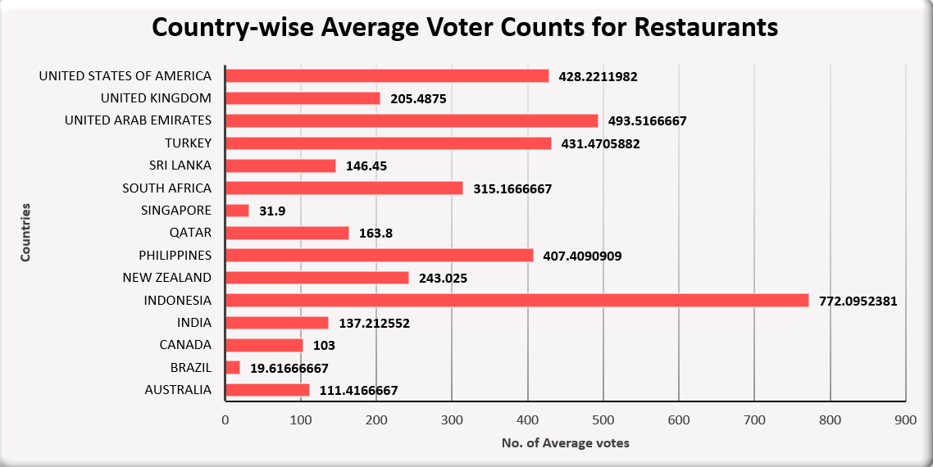
Global voting average for restaurants:
High engagement: Indonesia (772.1), UAE (493.5), Turkey (431.5), Philippines (407.4), and the USA (428.2) have the highest average voter counts, indicating strong customer participation and popularity.
Low engagement: Countries like Brazil (19.6), Singapore (31.9), and Canada (103) have significantly lower voter counts, suimprovement: India (137.2), Sri Lanka (146.4), and Australia (111.4) show moderate engagement but could benefit from increased visibility.ggesting either a lack of awareness or less active customer reviews.

Slide 10
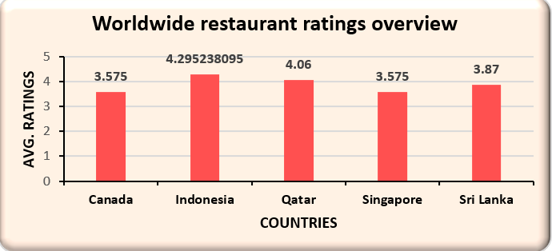
High Rated | Mid-Rated | Low-Rated
Indonesia (4.29) | Sri-Lanka(3.87) | Canada (3.575)
Qatar (4.06) |  | Singapore (3.575)
Global Restaurant Ratings Insights :
Indonesia and Qatar could be ideal locations for new restaurant investments as they have high ratings but fewer restaurants, it presents a great opportunity for business growth and expansion.
Canada and Singapore should focus on addressing customer concerns, they should analyze customer feedback, improve service quality, and enhance dining experiences before expanding in those regions.

Slide 11
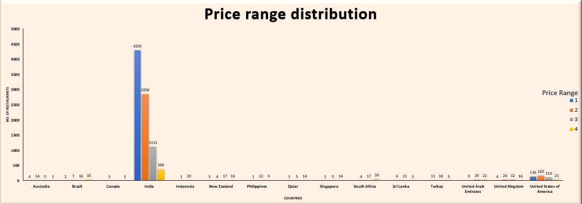
Understanding market expenditure behavior :
India has highest restaurant count across all price ranges while South Africa has more high-end restaurants than budget friendly ones.
Focus on mid-range pricing in India to capture a broader audience.
Introduce budget-friendly options or price ranges in South Africa to tap into an underserved segment.
Adjust marketing strategies based on country-specific pricing preferences; the least price ranged restaurants should be focused first as to interact with all budget individuals.

Slide 12
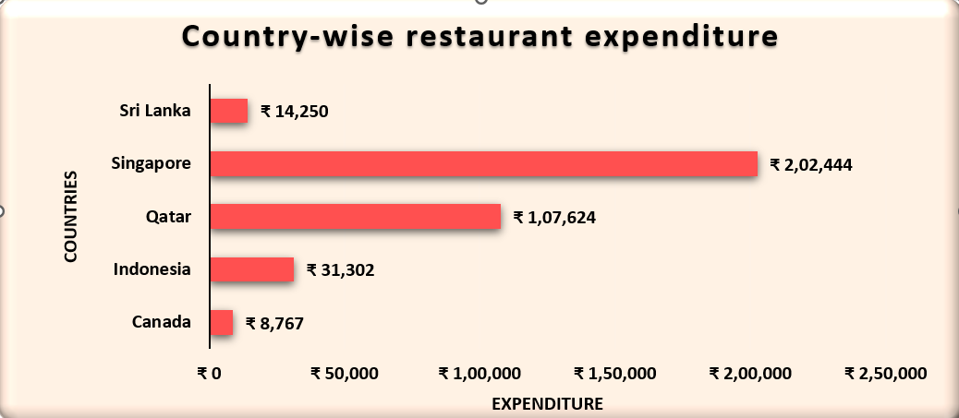
Global Restaurants Expenditure analysis :
Singapore and Qatar have the highest restaurant expenditures, indicating high spending power and demand for premium dining experiences.
Indonesia and Sri Lanka show moderate spending, suggesting potential for growth in mid-range dining options.
Canada has an extremely low expenditure, possibly indicating a lack of restaurant market presence or data collection gaps.
Indonesia and Sri Lanka could benefit from affordable dining options and marketing strategies to boost spending.

Slide 13
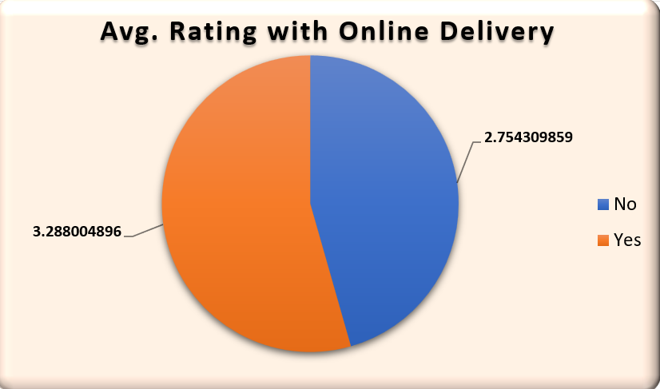
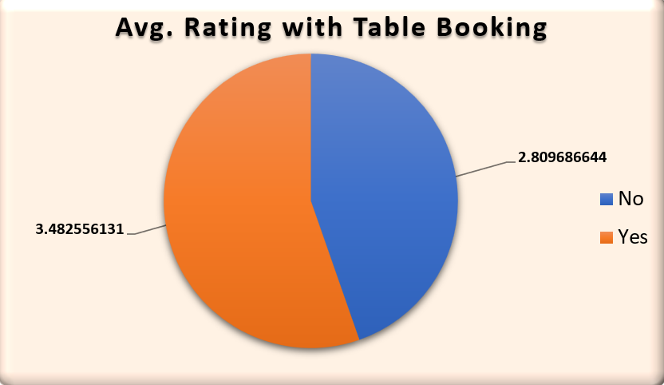
Online Delivery and Table Booking Analysis:
Online Delivery: Restaurants with delivery services rate higher (3.288 vs. 2.754), showing customer preference for convenience.
Table Booking: Structured reservations boost ratings (3.482 vs. 2.809), enhancing the dining experience.
Expand Online Delivery & Table Booking: Implement these services across all restaurant locations to enhance customer satisfaction and improve ratings.
Optimize User Experience: Ensure smooth booking processes, efficient delivery services, and high service quality.
Monitor Performance: Regularly track customer feedback and refine service operations to maintain high ratings.

Slide 14
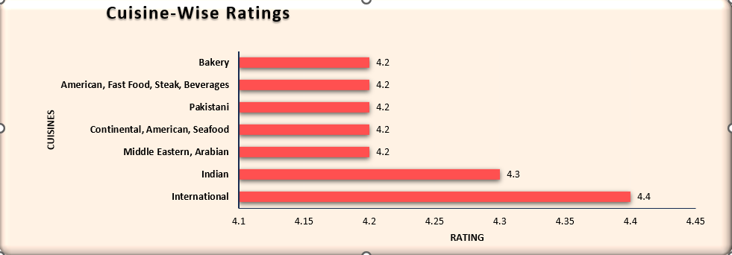
Top cuisines analysis :
International and Indian cuisines lead in customer satisfaction, with 4+ ratings reflecting strong preferences. Expanding these top-rated cuisines in new locations will enhance customer engagement.
Focus on regional adaptations to cater to local preferences, many won’t prefer the high-rated cuisines but their native regional,as Indians may go for Indian food(North Indian here) and respectively others prefer their regional dish.
Use customer reviews & ratings to periodically update the menu.
Offer seasonal and limited-time dishes based on emerging trends.

Slide 15
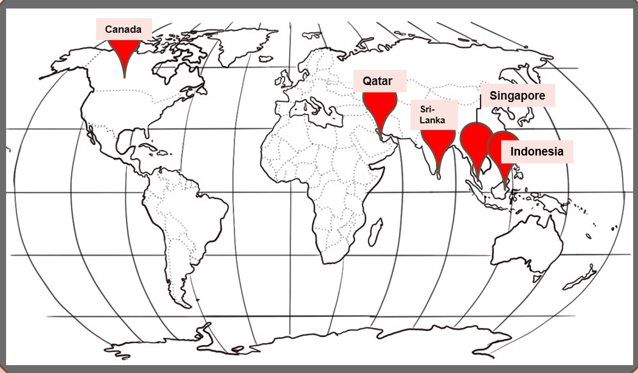
Canada
Qatar
Singapore
Sri-
Lanka
Indonesia
Expansion Opportunities Recommendations:
The countries with the least number of restaurants are fit for expansion opportunities with much less competition, with Canada having least restaurants(4),Qatar(20),Singapore(20),Sri Lanka(20), Indonesia(21).
Due to limited restaurants, we can enter an untapped or less saturated market.
There will be Higher chances of business success due to limited competition and an opportunity to become an early market leader in those regions.

Slide 16

Service and Quality improvements
Optimizing Service & Elevating Quality
Ratings in Canada and Singapore are low(both at 3.575), investigate customer complaints and service issues before expanding.
Ratings are high but restaurant numbers are low in Indonesia(21) and Qatar(20), consider immediate expansion as customer satisfaction is already strong.
Improve service quality for online orders in Sri Lanka where the average rating is moderate (3.27).

Slide 17


Online delivery
Vs
Table Booking
Optimizing Reservations: Online vs. Table Booking Strategy
Analysis of order data reveals that online delivery surpasses table booking by 1,293 orders, highlighting a clear customer preference for convenience. This trend underscores the increasing reliance on digital platforms for food services, making it crucial to prioritize online delivery for business expansion.
Restaurants offering online delivery received an average rating of 3.27, indicating moderate customer satisfaction, which can be improved for further retention by measures like last-mile delivery and opening more cloud kitchens.

Slide 18
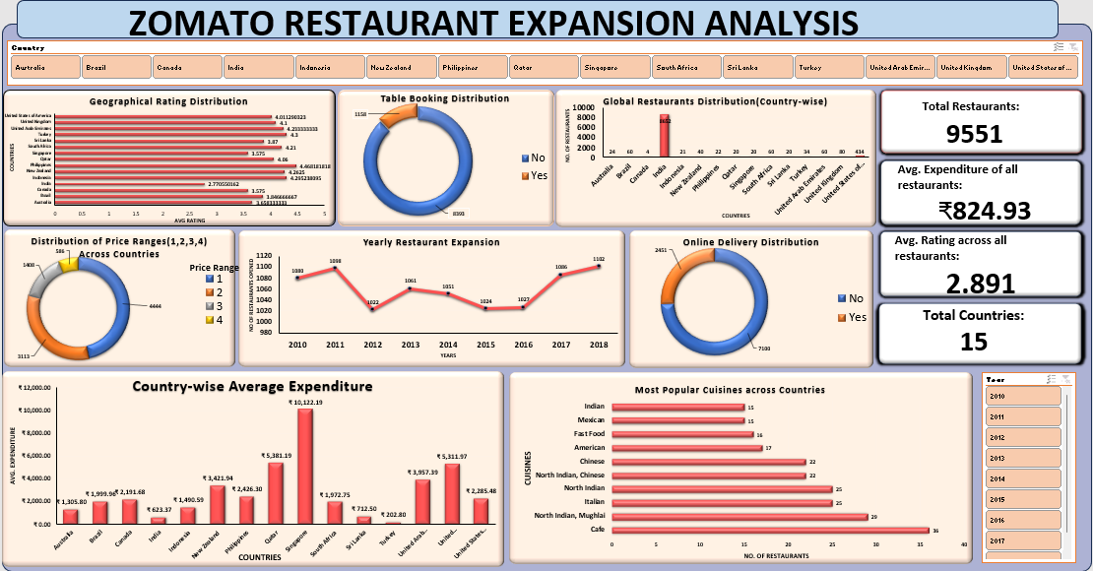
DASHBOARD

Slide 19
CONCLUSION
Target High-Growth, Low-Competition Markets for Expansion
Canada, Qatar, Singapore, Sri Lanka, and Indonesia have low restaurant penetration but high engagement potential. Early entry gives Zomato a first-mover advantage.
Prioritize Indonesia and Qatar for expansion, leveraging high ratings and moderate spending. Use localized pricing to attract mid-tier and budget-conscious diners.
Dominate Online Delivery by Enhancing Service Quality
Online delivery surpasses table bookings, proving a shift toward digital-first dining. However, average online ratings (3.28) indicate room for improvement in service quality.
Optimize last-mile delivery and reduce service delays to enhance customer experience.
Expand partnerships with cloud kitchens in high-demand but low-restaurant-density areas.
Boost Customer Engagement to Strengthen Market Presence
Engagement is weak in Canada, Brazil, and Singapore suffer from low customer interaction, increasing engagement in weaker markets will drive repeat customers.
Introduce rewards programs to encourage frequent orders.
Run localized marketing campaigns in Canada, Brazil, and Singapore to improve brand recall.

Slide 20
References
Google Finance
Elluminatiinc:How Does Zomato Work, Zomato Business Model, and Revenue Insights

Slide 21
THANK YOU

